Slide 1


The Sounds of Language
An exploration of Phonetics, Articulation, and the hidden mechanics of human speech.

Slide 2






INTRO QUIZ
English has 26 letters... but how many sounds does it have?
(This mismatch is why we need Phonetics!)

Slide 3

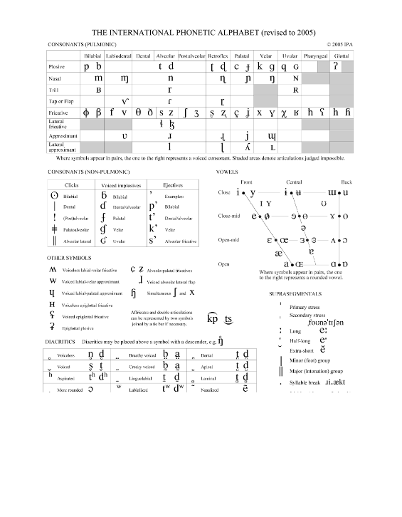



The Analytical Framework Phonetics
Phonetics is the general study of speech sound characteristics. It has three main branches:
Articulatory
How sounds are made (mouth, tongue, lungs).
Acoustic
The physical properties of sound waves.
Auditory
How we perceive sounds via the ear.

Slide 4



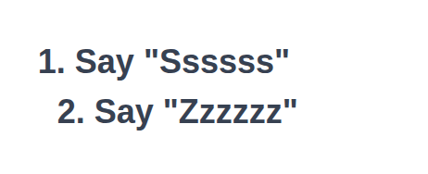
PHYSICAL CHALLENGE
The "Throat Touch" Test
Place your fingers gently on your Adam's apple.
(Snake)
(Bee)
Can you feel the difference?

Slide 5

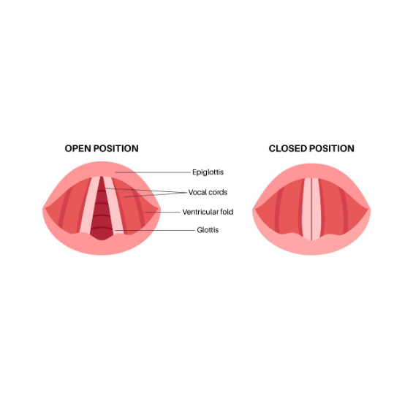


Voiced vs. Voiceless The Mechanics
It's all in the Larynx
The vibration you felt comes from the vocal folds (vocal cords).
Voiceless (Open)
Folds spread apart. Air passes clearly. Examples: [s], [f], [t], [k]
Voiced (Vibrating)
Folds drawn together. Air pushes through. Examples: [z], [v], [d], [g]

Slide 6



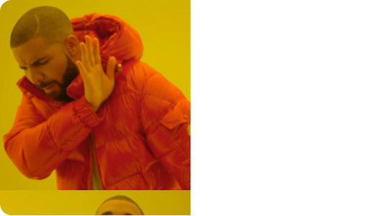

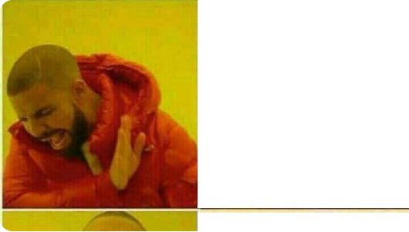

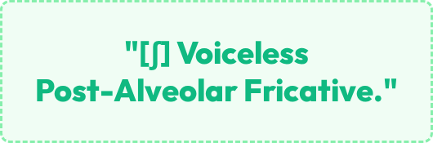
Why we need the IPA...

Slide 7



ARTICULATION MAP
Where is your tongue?
Say these three words and freeze your tongue.
POP
TOT
KICK
(Lips?)
(Teeth?)
(Back?)

Slide 8

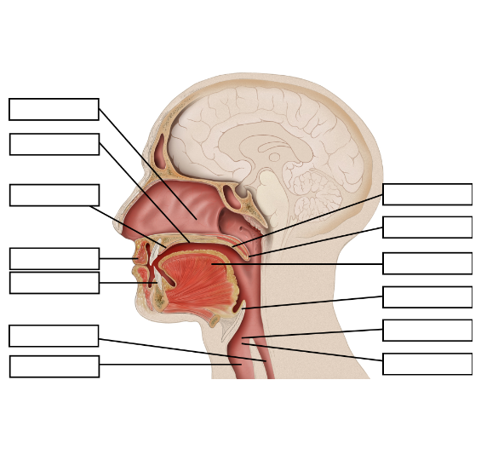
Place of Articulation The Map
We classify consonants based on where the air constriction happens in the vocal tract.
Lips: Bilabials
Teeth: Dentals & Labiodentals
Ridge: Alveolars
Roof: Palatals
Back: Velars

Slide 9



The Front Lips & Teeth
Bilabials
Labiodentals
Dentals
Using both lips.
Upper teeth + Lower lip.
Tongue tip behind/between teeth.
[p] Pop [b] Bob [m] Mom [w] Wet
[f] Fat [v] Vat
[θ] Thin (Theta) [ð] Thus (Eth)

Slide 10


The Middle Ridge & Roof
Alveolars
Palatals
Tongue tip touches the Alveolar Ridge (bumpy part behind top teeth).
Tongue and the hard Palate (roof of mouth).
[ʃ] Ship
[ʒ] Casual
[t] Top
[d] Dog
[ʧ] Chip
[ʤ] Gem
[s] Sit
[z] Zoo
[j] Yet
[n] Nut
[l] Lap

Slide 11




The Back Velars & Glottals
Velars
Glottals
Back of tongue touches Velum (Soft Palate).
Space between vocal folds.
[h] Hat
[k] Cat, Kick
Air passes through without active tongue use.
[g] Gun
These are the furthest back sounds in English.
[ŋ] Bang (Angma)
*Note: No [g] sound in "ringing"

Slide 12
Consonant Summary The Big Picture
Place | Voiceless | Voiced | Example Articulators
Bilabials | [p] | [b], [m], [w] | Both lips
Labiodentals | [f] | [v] | Upper teeth + Lower lip
Dentals | [θ] (thin) | [ð] (then) | Tongue tip + Upper teeth
Alveolars | [t], [s] | [d], [z], [n], [l], [r] | Tongue tip + Alveolar ridge
Palatals | [ʃ], [ʧ] | [ʒ], [ʤ], [j] | Tongue + Palate
Velars | [k] | [g], [ŋ] | Back tongue + Velum
Glottals | [h] | - | Vocal folds

Slide 13







Image Sources
https://plus.unsplash.com/premium_photo-1756965210862-9334067f185a?fm=jpg&q=60&w=3000&ixlib=rb-4.1.0&ixid=M3wxMjA3fDB8MHxwaG90by1yZWxhdGVkfDE1fHx8ZW58MHx8fHx8
Source: unsplash.com
https://www.internationalphoneticassociation.org/sites/default/files/IPA2005_1000px.png
Source: www.internationalphoneticassociation.org
https://cdn.vectorstock.com/i/500p/30/14/vocal-cord-anatomy-open-closed-vector-60223014.jpg
Source: www.vectorstock.com
https://supermeme-space-prd.ams3.cdn.digitaloceanspaces.com/templates/Drake-Hotline-Bling.png
Source: supermeme.ai
https://a.pinatafarm.com/720x728/91478a0b66/drake-hotline-approves.jpg
Source: www.pinatafarm.com
https://opentextbc.ca/psyclanguage/wp-content/uploads/sites/356/2021/02/The-Vocal-Tract_h5p-e1683664005178.png
Source: opentextbc.ca

